Slide 1
DevelopersHub Corporation February 2026
MAJID HUSSAIN

Slide 2

Research & Campaign Plan — Social Connect (Target: 18–35 in Pakistan)
Key Psychographics
2–4 hours daily on social apps. Value authenticity, privacy control, and community belonging. Heavy mobile data users and early adopters.
Competitor Insights
UGC & short-form video win. Influencer partnerships build trust. Algorithm fatigue is a major pain point to address.
Top Pain Points
Users are tired of irrelevant algorithmic feeds and want more meaningful connections. Conversion friction on app installs needs simplification.

Slide 3
Goals, KPIs & Content Strategy
Clear SMART goals guide the campaign: +25% reach (3 weeks), 500 app downloads (4 weeks), +1.5K followers (3 weeks), and 3,000 store clicks (4 weeks). KPIs: impressions, 3% baseline engagement, 70%+ video completion, and 500 downloads.
Content Mix
Reels (4–5/wk), Stories (daily), Feed Graphics (3/wk), YouTube Ads (1–2 variations), Search & Display for retargeting.
Content Themes
1) App tutorials & features 2) Social proof & influencer takeovers 3) Community spotlights & UGC
Ad Concepts
Top-funnel: vibrant montage + Download CTA. Retargeting: social proof + app rating creative. A/B test headlines & creatives to improve conversion.

Slide 4
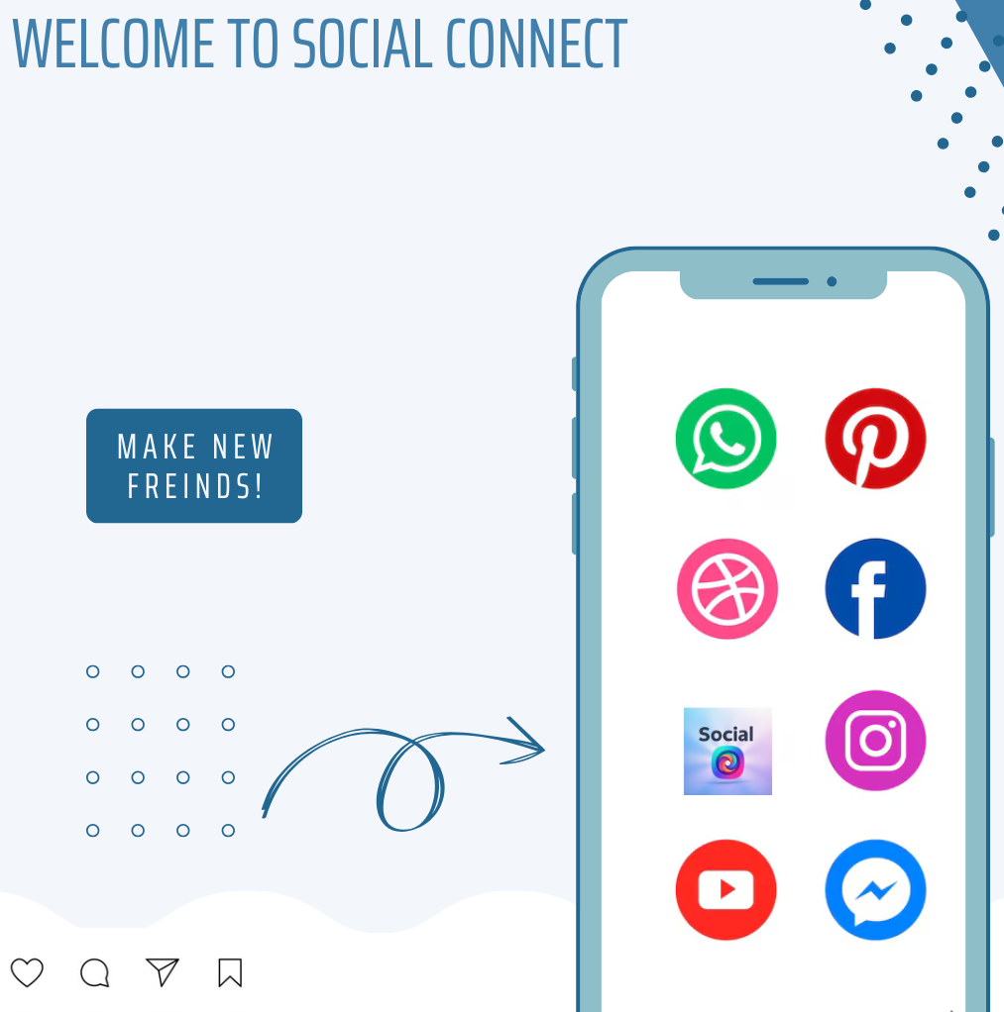
Content samples :

Slide 5
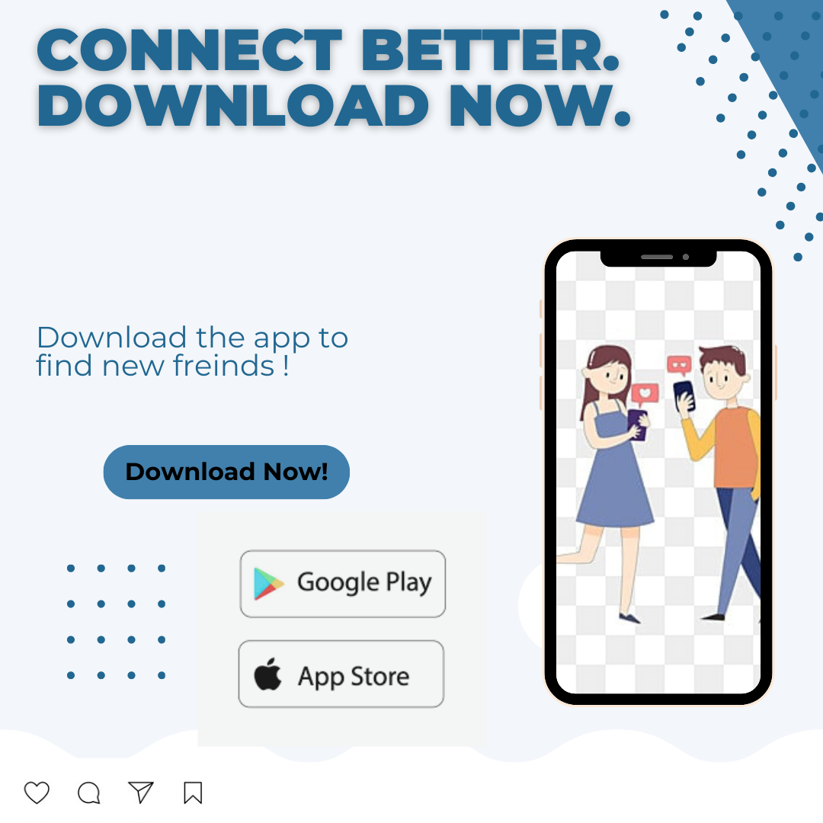
Content samples :

Slide 6
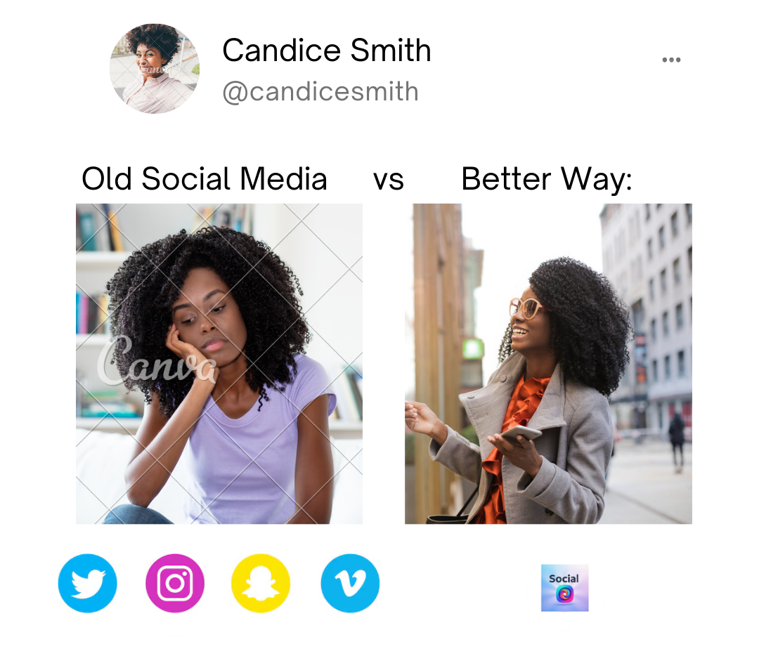
Content samples :

Slide 7
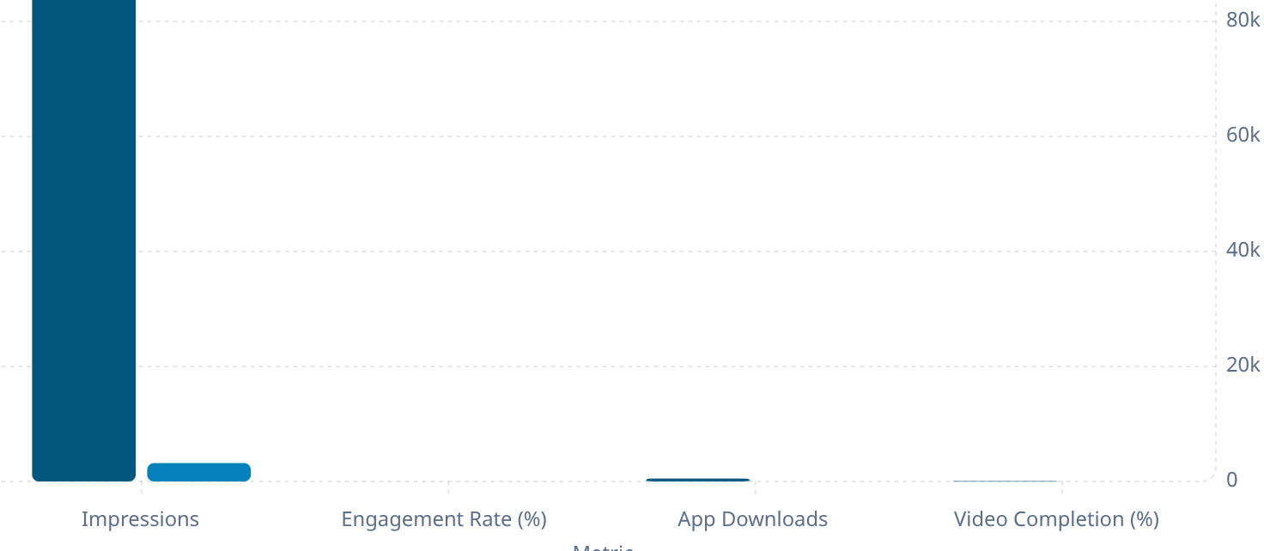

Slide 8
Performance & Optimization:
Week 3 insights: organic reach ~1,500 with 185 engagements (4.2% engagement rate , above the 3% benchmark). Test results show testimonial-style videos reached 2.5× the audience of static posts. Paid ads achieved 3,200 impressions but downloads lagged, signaling funnel friction.
Optimize Creative:
Increase Conversions:
Prioritize short-form video, swap static posts for quick tutorials and UGC. Use the color #87ADFD for creative accents and thumbnails.
A/B test headlines (e.g., “Meet Social Connect” vs “Tired of Random Feeds?”), strengthen CTAs, and simplify signup flows to turn clicks into downloads.
Community & Influencers:
Partner with micro-influencers for authentic reach, and incentivize UGC with reposts and community spotlights to build trust and retention.

Slide 9
Lessons Learned & Recommendations
Key Lessons
Short-form videos perform best – Reels generated 2.5× higher reach than static posts.
Relatable content increases engagement – Posts addressing user pain points attracted more interactions.
Active community management builds trust – Achieved 100% response rate to DMs.
Ads generated interest but conversions were lower, indicating the need to improve the download journey.
Consistent posting improved visibility and audience engagement.

Slide 10
Lessons Learned & Recommendations
Recommendations
Focus more on short-form video and user-generated content (UGC).
Collaborate with micro-influencers to increase reach and credibility.
Optimize the conversion funnel (landing page and stronger CTAs).
Use A/B testing for ad creatives and headlines.
Continue data-driven optimization based on campaign metrics.

